Slide 1

What are Open Educational Resources?
Image: http://ocsld.brookesblogs.net/2012/02/09/another-successful-bid-openline/
Ms Zeynep Varoglu, UNESCO
Ms Trudi van Wyk, Commonwealth of Learning
Mr Neil Butcher, Neil Butcher and Associates
Notes:
Image: http://ocsld.brookesblogs.net/2012/02/09/another-successful-bid-openline/

Slide 2

A Basic Guide to OER
www.col.org/OERbasicguide

Slide 3







OER is NOT the same as…..
Online Learning

Slide 4


What is an OER?
Any educational resource/materials that may be freely accessed, reused, modified and shared
….openly available for use without paying royalties/licence fees
Image: http://foothillglobalaccess.pbworks.com/w/page/13095903/Open_Educational_Resources
http://www.globalkap.com/Industries/Legal

Slide 5


What is an OER?
Any educational resource/materials that may be freely accessed, reused, modified and shared
….openly available for use without paying royalties/licence fees
www
www
www
www
Image: http://education-portal.com/articles/Open_Education_Week_The_Open_Policy_Solution.html

Slide 6
What is an OER?
Any educational resource/materials that may be freely accessed, reused, modified and shared
….openly available for use without paying royalties/licence fees
Curriculum frameworks and maps
Course materials
Documents
Books
Research articles
Multimedia applications
Podcasts
Videos
Software and programmes…….etc

Slide 7

Open Licence
Free to access and share:
Give credit to the original author
If you change or build upon this work, you distribute it under the same open licence
For non-commercial use
Not allow to make derivatives/changes…..
by
nc
nd
sa
Other Rights — In no way are any of these rights affected by the license:
The author's intellectual property rights;
Your fair dealing or fair use rights, or other applicable copyright exceptions and limitations;
The author's moral rights;
Rights other persons may have either in the work itself or in how the work is used, such as publicity or privacy rights.
Notes:
Intellectual property rights, very broadly, are rights granted to creators and owners of works that are the result of human intellectual creativity.

Slide 8
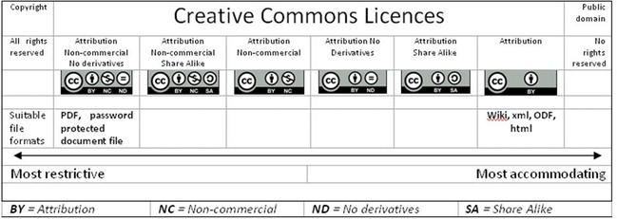
Licence Types

Slide 9

Questions?
What aspects of OER interest you? Why?
What potential benefits do you see from harnessing OER in your context?
Image: Commonwealth of Learning
Notes:
Guarantee quality????

Slide 10

Using OER
Share
Contribution
Customisation
Localisation
Translation
Contextualisation
Image: http://wikieducator.org/OERF:FAQs/Open_Education_Resources/
Notes:
Image: http://wikieducator.org/OERF:FAQs/Open_Education_Resources/

Slide 11

Benefits of harnessing OER?
Increased availability of high quality, relevant materials can contribute to quality teaching and learning
Adaptation of materials can be a mechanism for constructing roles of educators and students
Build capacity in production of high quality materials
Image: Commonwealth of Learning
Notes:
Guarantee quality????

Slide 12














Where do I find OER?
    OER search facilities
    OER repositories
    OER Directory sites

Slide 13
Materials Development Process
Evaluation
Analysis
Design
Development
Production
Delivery
Revise
Map Curriculum
Identify OER
Determine OER Usage
Create Usage Guides
Notes:
Guarantee quality????

Slide 14
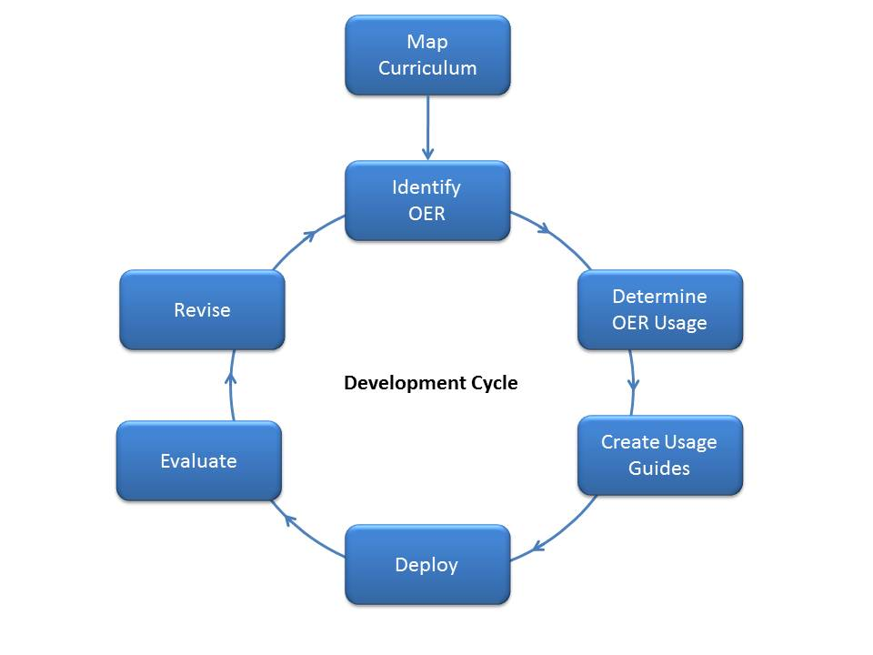
Materials Development Process
Notes:
Guarantee quality????

Slide 15
What can governments do to embrace OER?
    Fostering awareness and use of OER
    ICT and connectivity strategies
    Include OER in educational policy and strategies
    Promote and adopt open licencing frameworks
    Support sustainable development and sharing of OER
    Foster strategic alliances for OER
    Advocacy
    Address language and cultural contexts
    Promote more research in OER
    Facilitate finding, retrieving and sharing of OER
Notes:
Guarantee quality????

Slide 16
What can institutions do to embrace OER?
    Institutional strategies for the integration of OER
    Incentives for development, acquisition and adaptation of quality teaching and learning materials
    Quality teaching and learning materials as part of internal quality processes
    Flexible IPR and copyright policies
    Advocacy and capacity building
    ICT and connectivity
    Facilitate finding, retrieving and sharing of OER
Notes:
Guarantee quality????

Slide 17
Why should OER become a matter of public (open) policy?
The basic argument of open policy is that when public money is used to fund research, development or other educational, academic and information-generating activities, the product of those activities should be freely available to the public that paid for it.
Dr Cable Green, Creative Commons

Slide 18



Images: Commonwealth of Learning

Slide 19
http://col-oer.weebly.com

Slide 20

Thank you
Image: http://anulik.edublogs.org/2010/11/22/skype-conferance-based-on-oer/
Notes:
Image: http://anulik.edublogs.org/2010/11/22/skype-conferance-based-on-oer/

